Slide 1
Self-Driving Delivery Emulation System
2019-09-10
Bryan

Slide 2
需安裝的東西
XAMPP
下載java-jdk
下載java-jre

Slide 3
大綱
前提先調整IP address
network_security_config.xml
strings.xml
XAMPP
phpMyAdmin
Run SUMO by eclipse
下載最新版本
環境變數設置
匯入eclipse專案
Android studio
Notes:
--
手機面:
安裝app的軟體: 版本、載點、安裝這個軟體的流程
如何在手機上安裝app、更新app
--
App面
AV_Delivery_v10資料夾簡述https://github.com/YenKang/Smart-Logistics-Plan/tree/master/AV_Delivery_v10/app/src/main/res/values
如何修改app的介面(文字)
--
Server面
--
SUMO面

Slide 4
從Android的code調整IP address
參考網址1: https://github.com/YenKang/Smart-Logistics-Plan/blob/master/AV_Delivery_v10/app/src/main/res/values/strings.xml
參考網址2: https://github.com/YenKang/Smart-Logistics-Plan/blob/master/%5B190912%5DAV_Delivery_v10/app/src/main/res/xml/network_security_config.xml
紅色ip address要換成執行SUMO PC地點的ip
140.116.72.134 是SUMO server的IP address

Slide 5
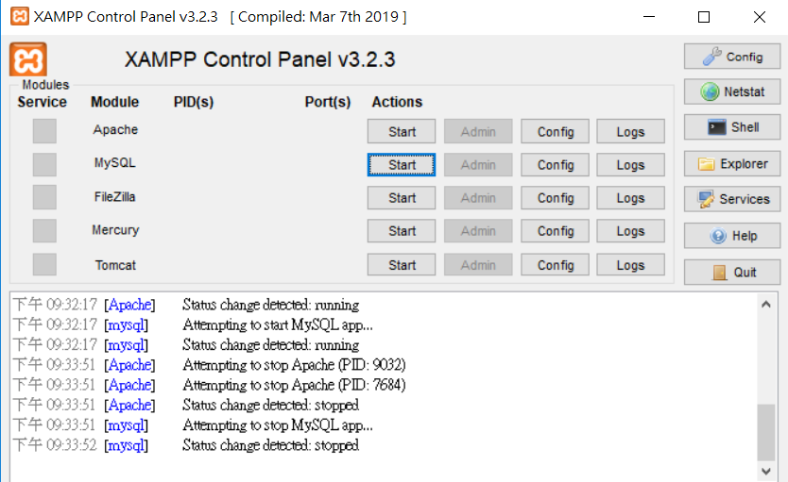
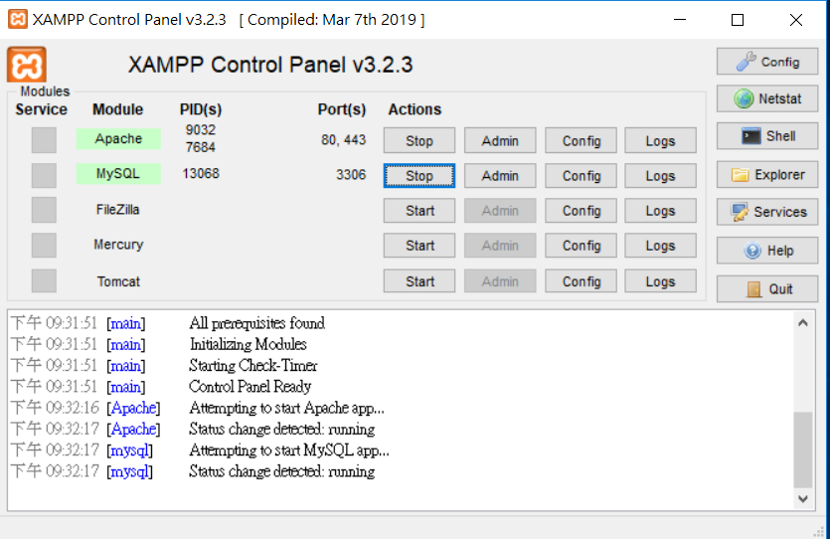
PUSH START BOTTON OF APACHE and MySQL
BEFORE
AFTER

Slide 6
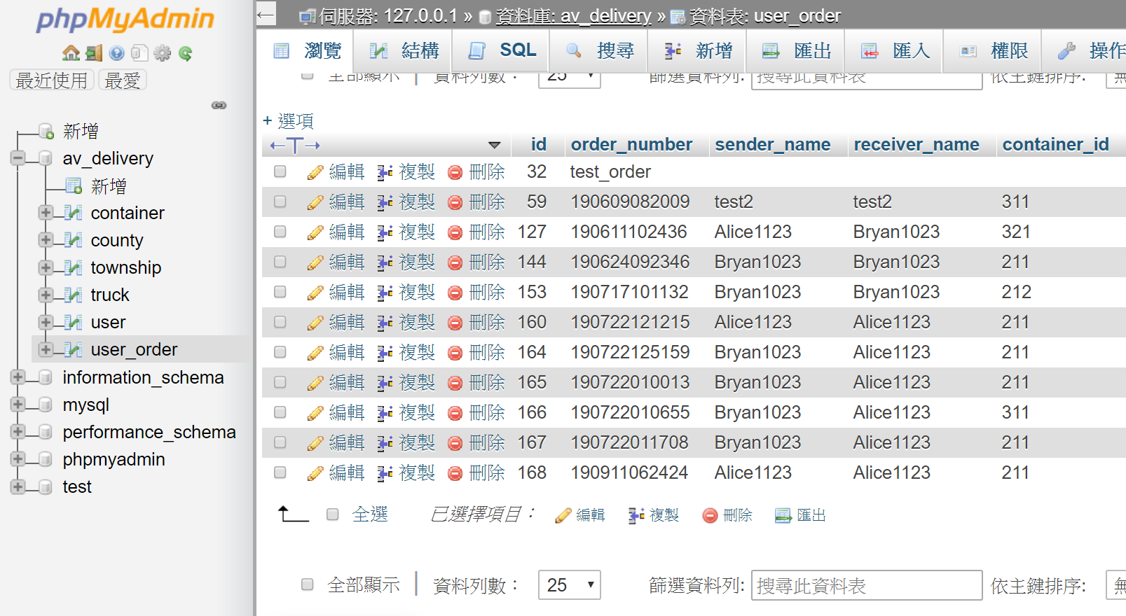
phpMyAdmin (要先開啟XAMP)

Slide 7
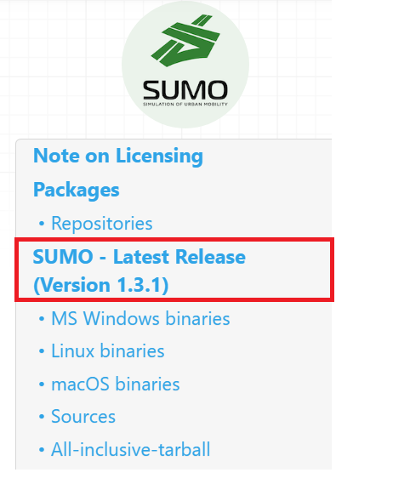
下載最新板本SUMO
網址:https://sumo.dlr.de/docs/Downloads.html

Slide 8
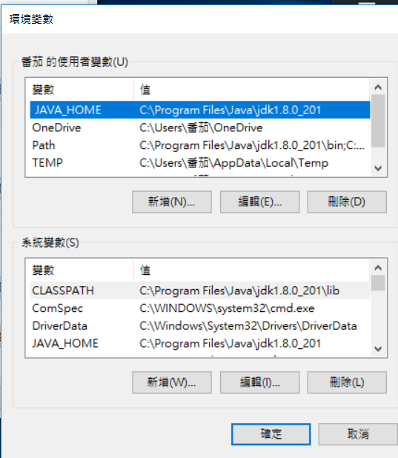
環境變數
變數 | 值
JAVA_HOME | C:\Program Files\Java\jdk1.8.0_201
path | C:\Program Files (x86)\Common Files\Oracle\Java\javapath
path | C:\Program Files (x86)\Eclipse\Sumo\bin
path | C:\Program Files\Java\jdk1.8.0_201\bin
PYTHONPATH | C:\Program Files (x86)\Eclipse\Sumo\tools\
SUMO_HOME | C:\Program Files (x86)\Eclipse\Sumo\
CLASSPATH | C:\Program Files\Java\jdk1.8.0_201\lib

Slide 9
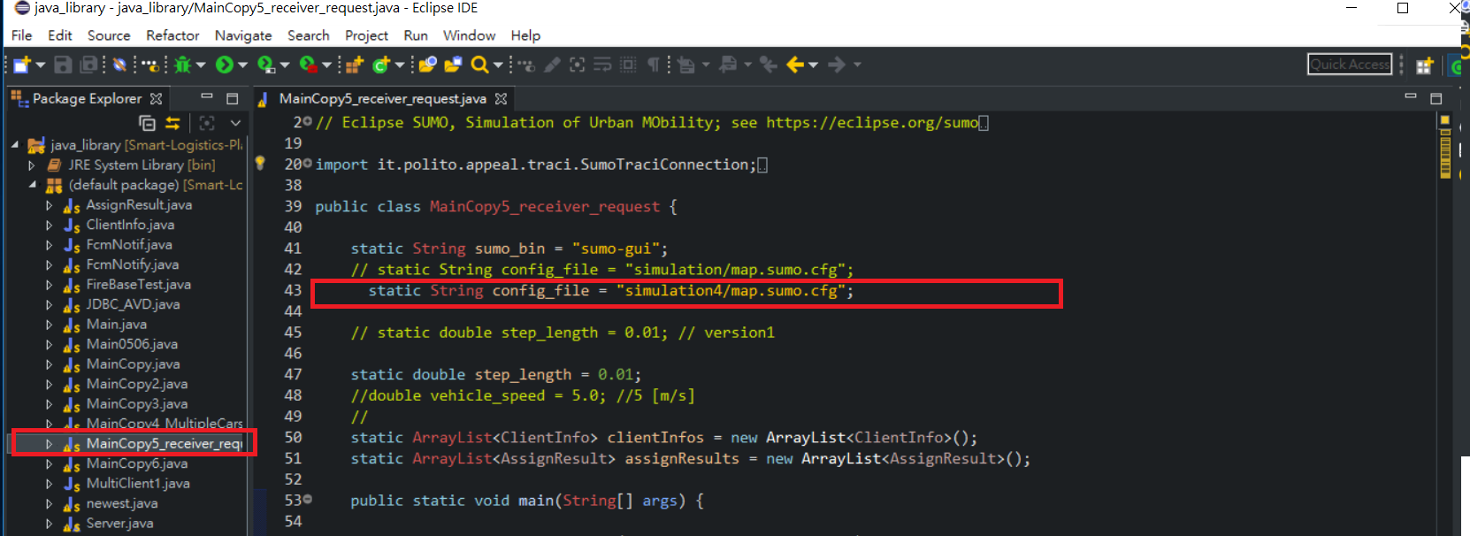
Eclipse

Slide 10
Import Project from File System or Archive
Import source: C:\Users\yen\Documents\GitHub\Smart-Logistics-Plan\eclipse workspace\java_library\java_library
教學影片網址:https://github.com/YenKang/Smart-Logistics-Plan/blob/master/document/video/%5B190911%5Declipse%E5%8C%AF%E5%85%A5%E6%AA%94%E6%A1%88.mp4

Slide 11
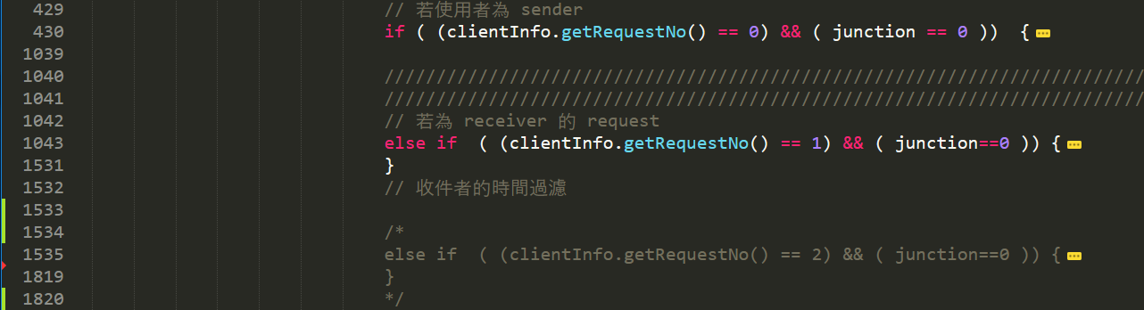
Code of SUMO server

